Slide 1
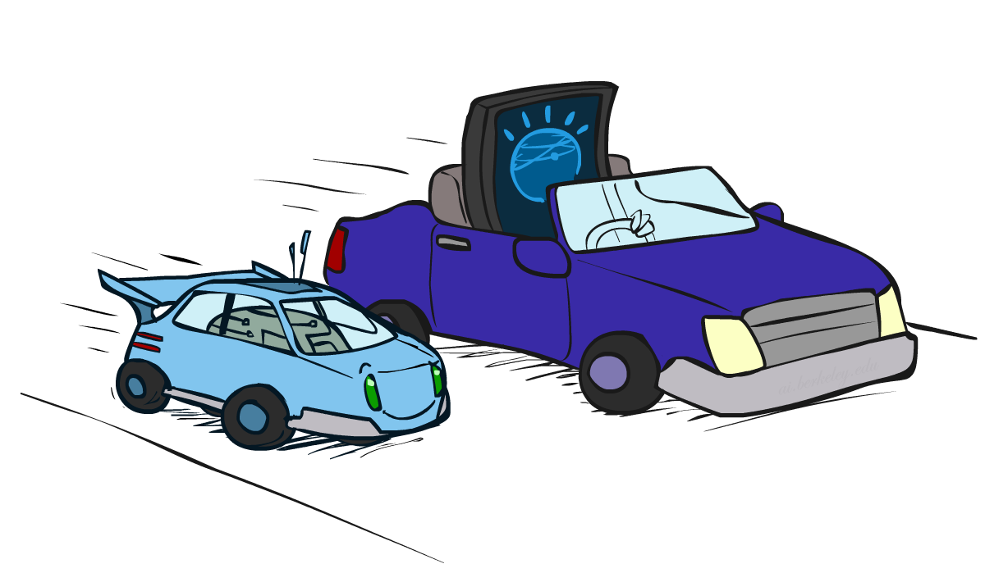
CS 188: Artificial Intelligence
NLP, Games, and Robotic Cars *
Instructors: Dan Klein and Pieter Abbeel --- University of California, Berkeley
[These slides were created by Dan Klein and Pieter Abbeel for CS188 Intro to AI at UC Berkeley. All CS188 materials are available at http://ai.berkeley.edu.]
Notes:
Please retain proper attribution, including the reference to ai.berkeley.edu. Thanks!

Slide 2
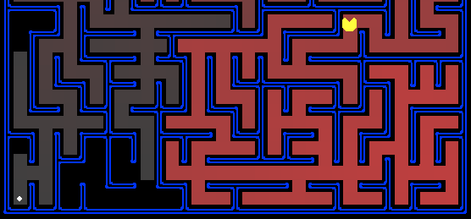
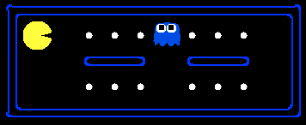
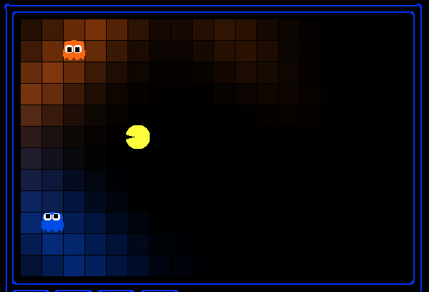
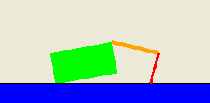
So Far: Foundational Methods

Slide 3
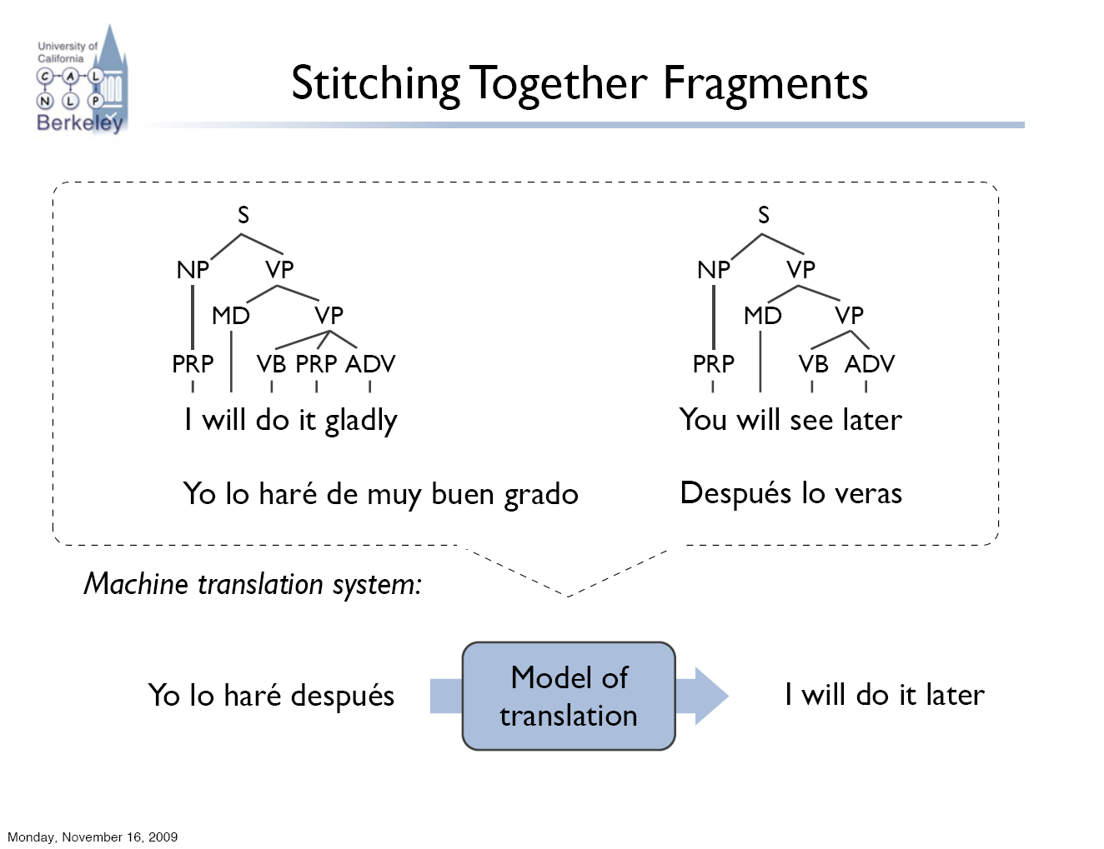
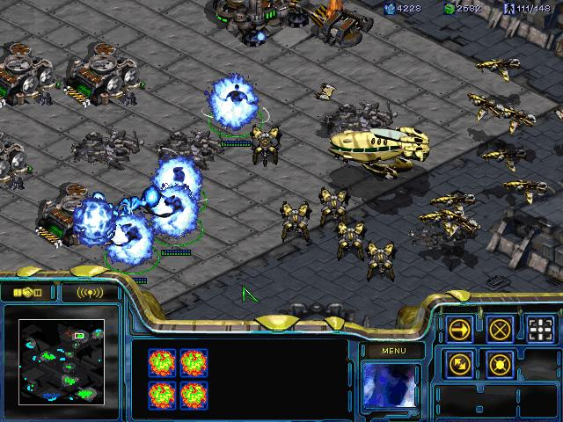
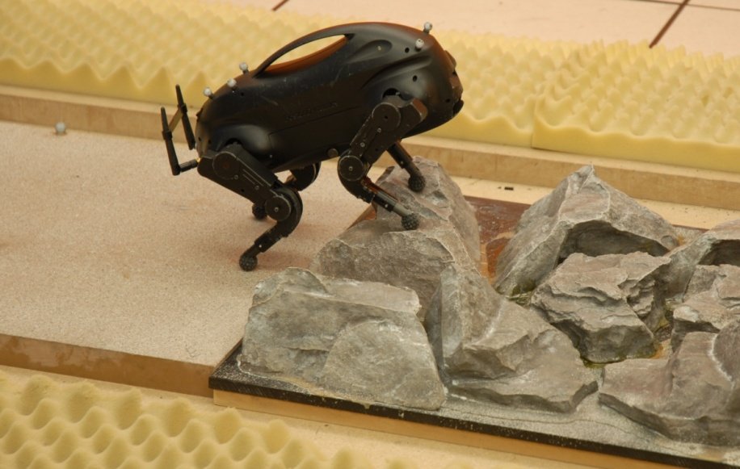
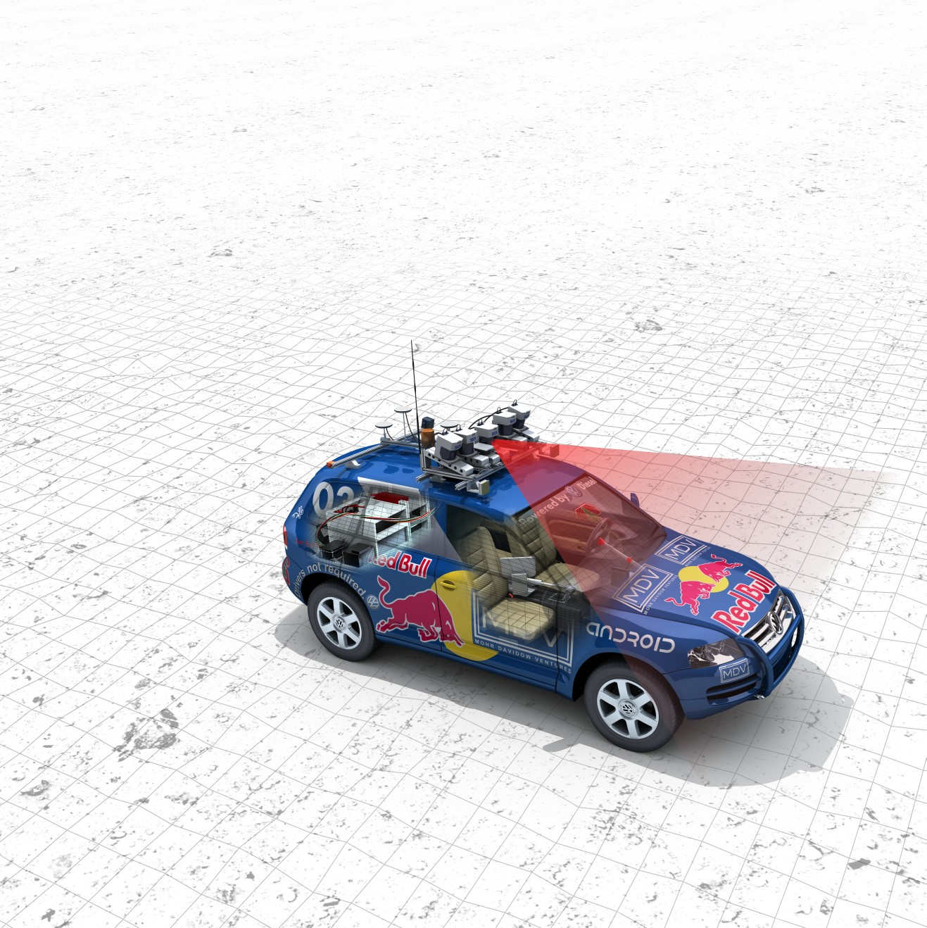
Now: Advanced Applications

Slide 4
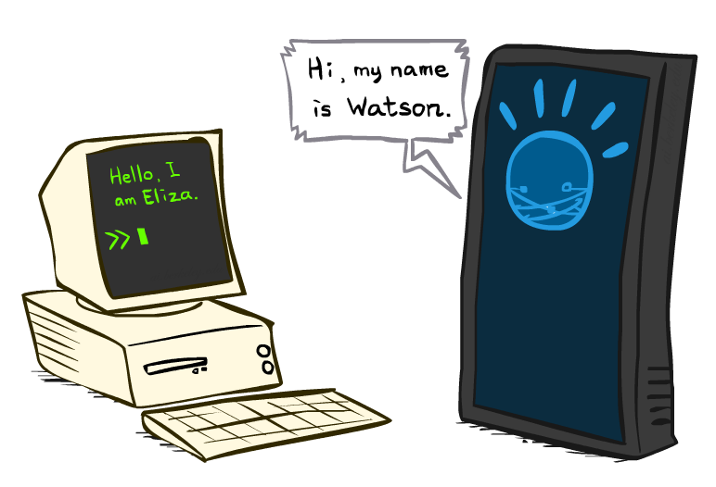
Natural Language Processing

Slide 5
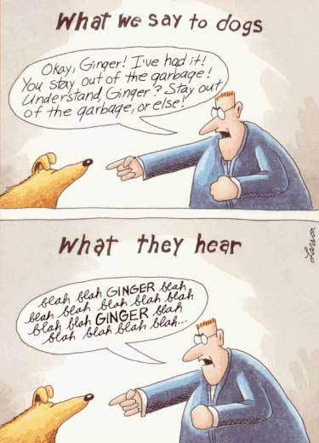
What is NLP?
Fundamental goal: analyze and process human language, broadly, robustly, accurately…
End systems that we want to build:
Ambitious: speech recognition, machine translation, information extraction, dialog interfaces, question answering…
Modest: spelling correction, text categorization…

Slide 6
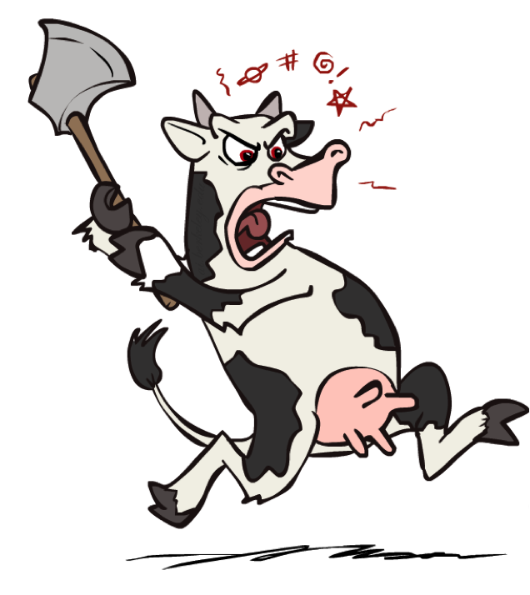
Problem: Ambiguities
Headlines:
Enraged Cow Injures Farmer With Ax
Hospitals Are Sued by 7 Foot Doctors
Ban on Nude Dancing on Governor’s Desk
Iraqi Head Seeks Arms
Local HS Dropouts Cut in Half
Juvenile Court to Try Shooting Defendant
Stolen Painting Found by Tree
Kids Make Nutritious Snacks
Why are these funny?

Slide 7
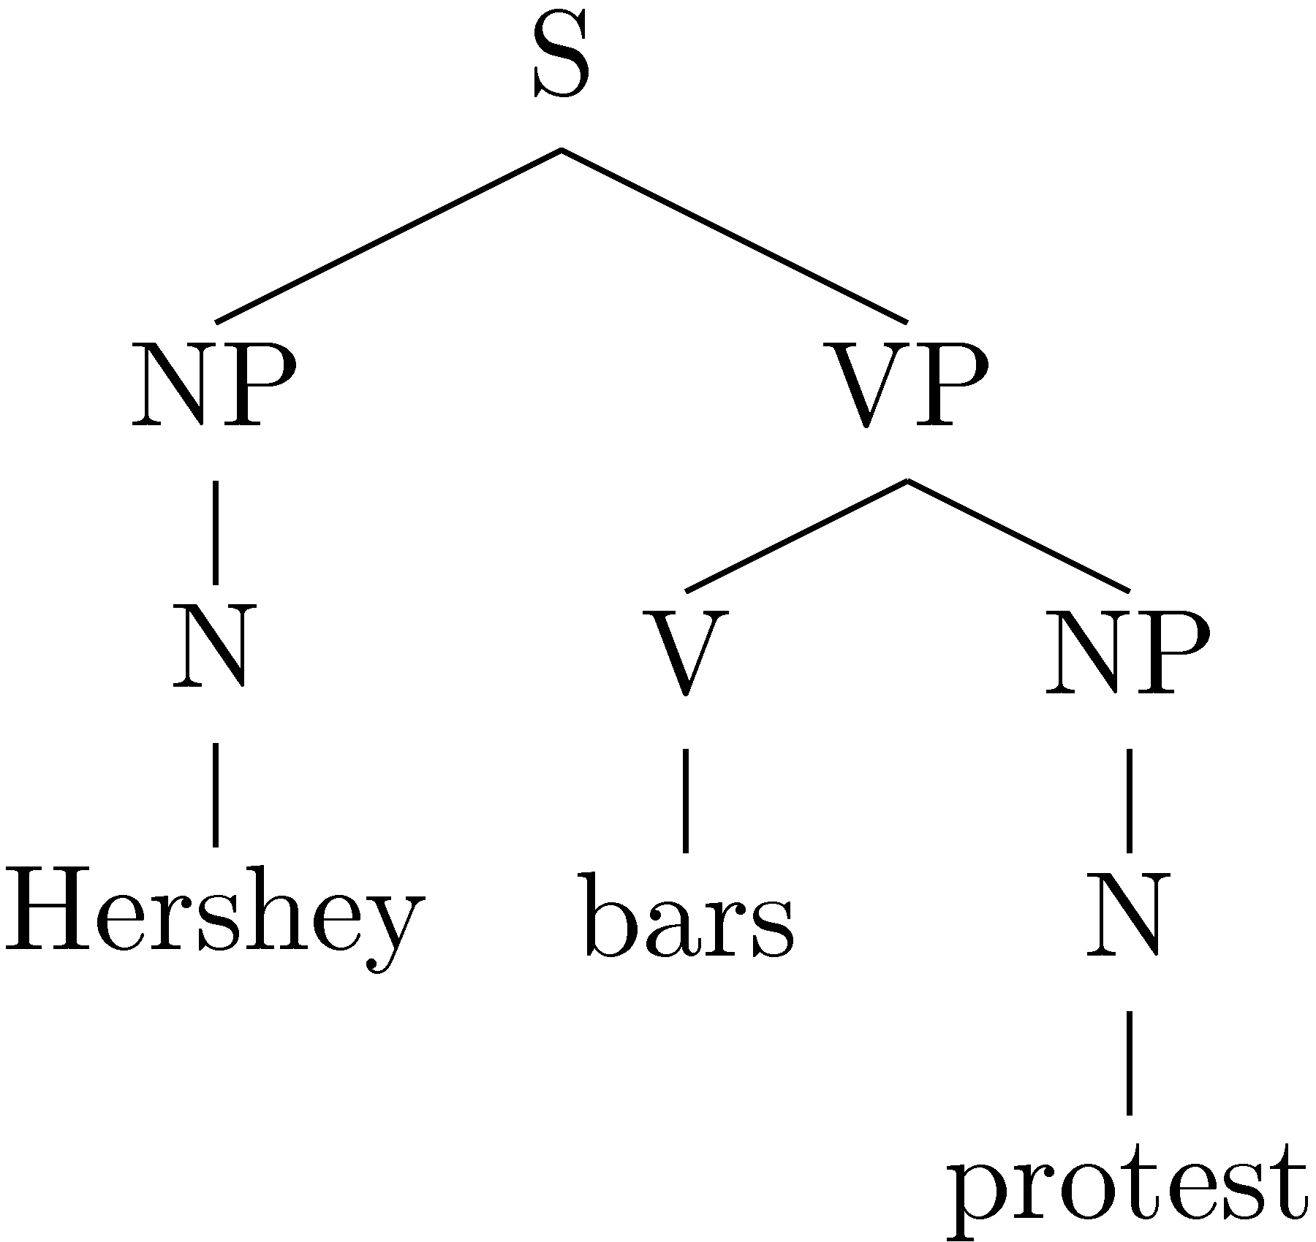
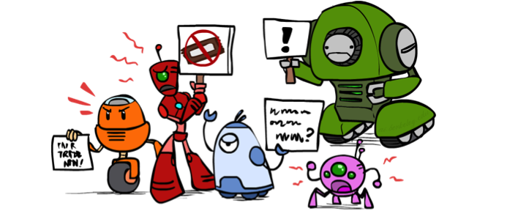
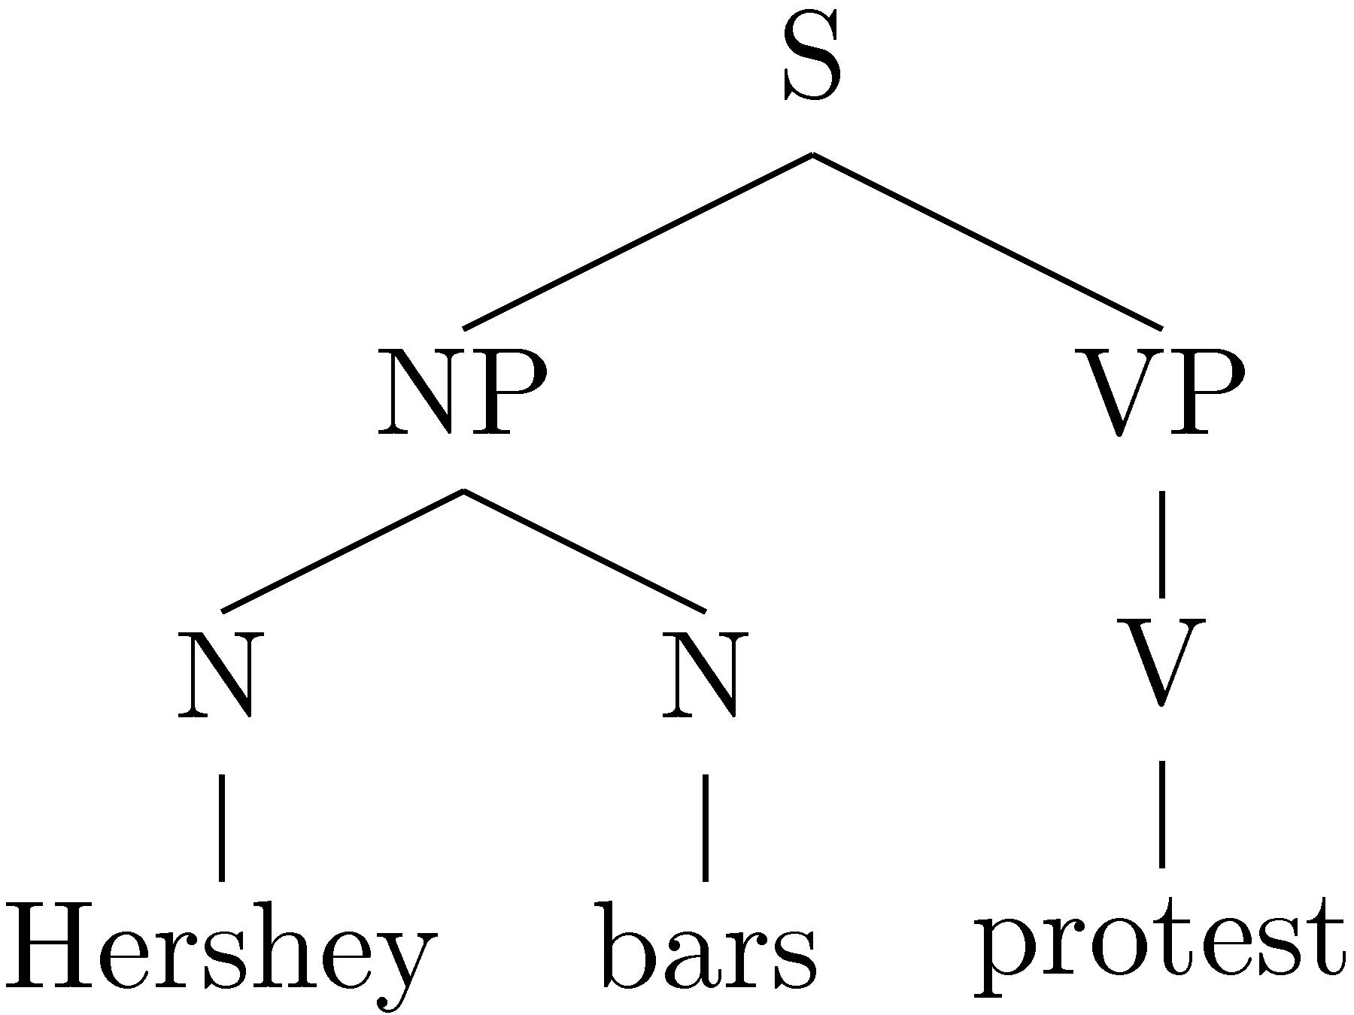

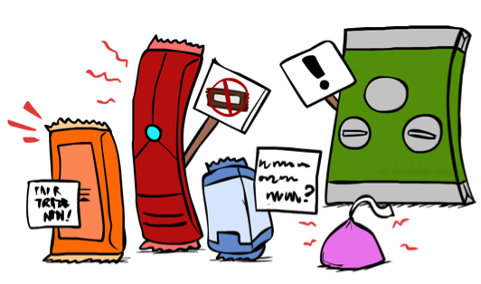
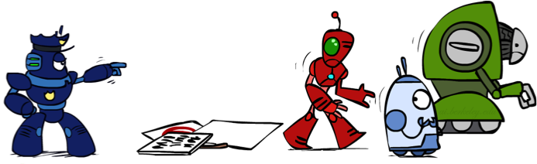
Parsing as Search

Slide 8
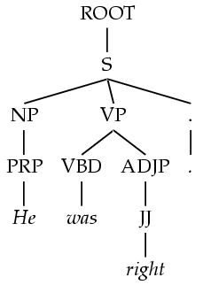
Grammar: PCFGs
Natural language grammars are very ambiguous!
PCFGs are a formal probabilistic model of trees
Each “rule” has a conditional probability (like an HMM)
Tree’s probability is the product of all rules used
Parsing: Given a sentence, find the best tree – search!
ROOT → S 375/420
S → NP VP . 320/392
NP → PRP 127/539
VP → VBD ADJP 32/401
…..

Slide 9
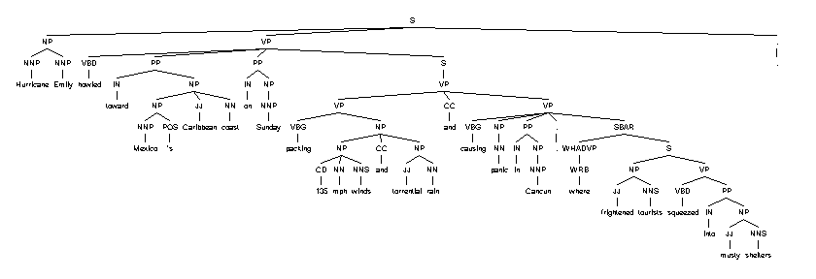
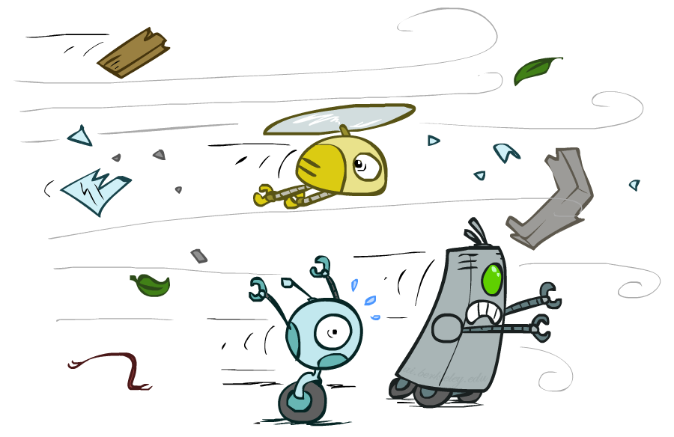
Syntactic Analysis
Hurricane Emily howled toward Mexico 's Caribbean coast on Sunday packing 135 mph winds and torrential rain and causing panic in Cancun, where frightened tourists squeezed into musty shelters.
[Demo: Berkeley NLP Group Parser http://tomato.banatao.berkeley.edu:8080/parser/parser.html]

Slide 10
Dialog Systems

Slide 11

ELIZA
A “psychotherapist” agent (Weizenbaum, ~1964)
Led to a long line of chatterbots
How does it work:
Trivial NLP: string match and substitution
Trivial knowledge: tiny script / response database
Example: matching “I remember __” results in “Do you often think of __”?
Can fool some people some of the time?
[Demo: http://nlp-addiction.com/eliza]

Slide 12

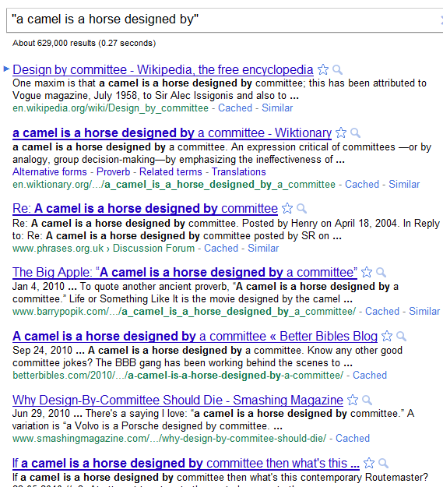
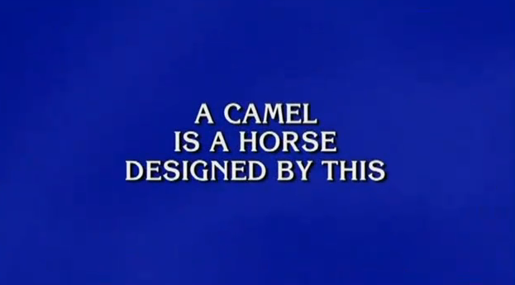
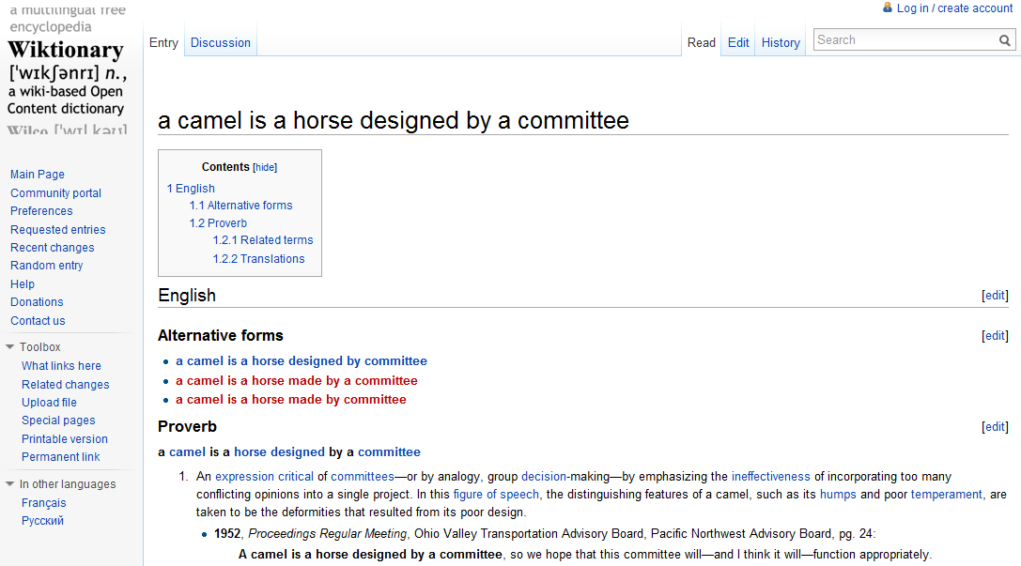
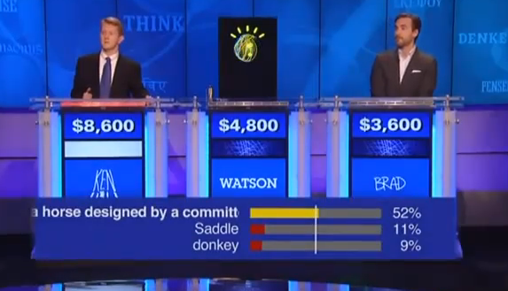
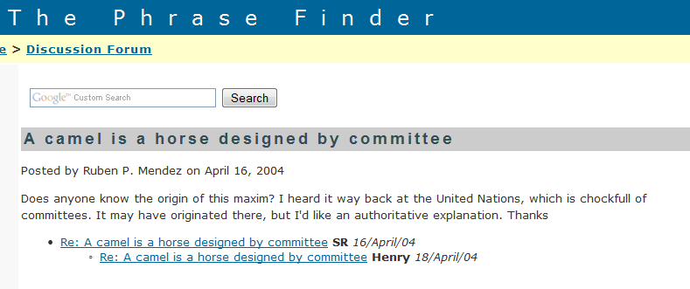
Watson

Slide 13

What’s in Watson?
A question-answering system (IBM, 2011)
Designed for the game of Jeopardy
How does it work:
Sophisticated NLP: deep analysis of questions, noisy matching of questions to potential answers
Lots of data: onboard storage contains a huge collection of documents (e.g. Wikipedia, etc.), exploits redundancy
Lots of computation: 90+ servers
Can beat all of the people all of the time?

Slide 14
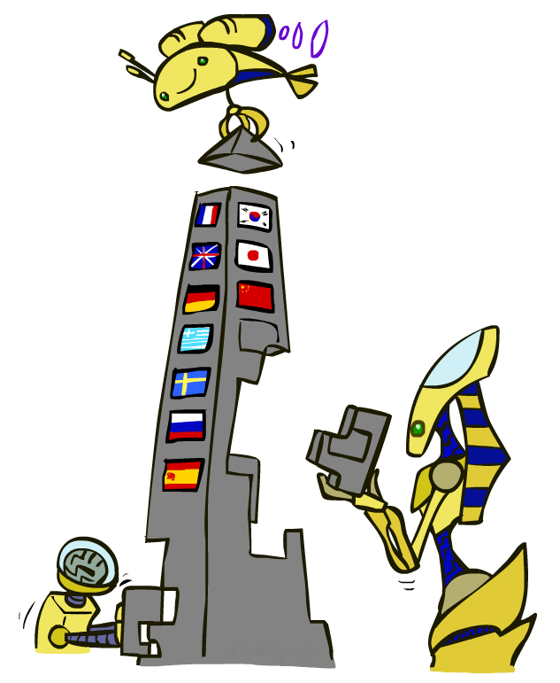
Machine Translation

Slide 15
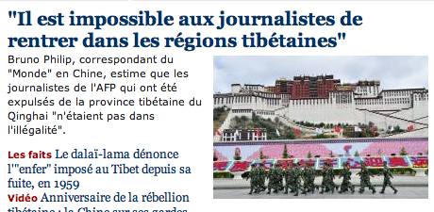

Machine Translation
Translate text from one language to another
Recombines fragments of example translations
Challenges:
What fragments? [learning to translate]
How to make efficient? [fast translation search]

Slide 16
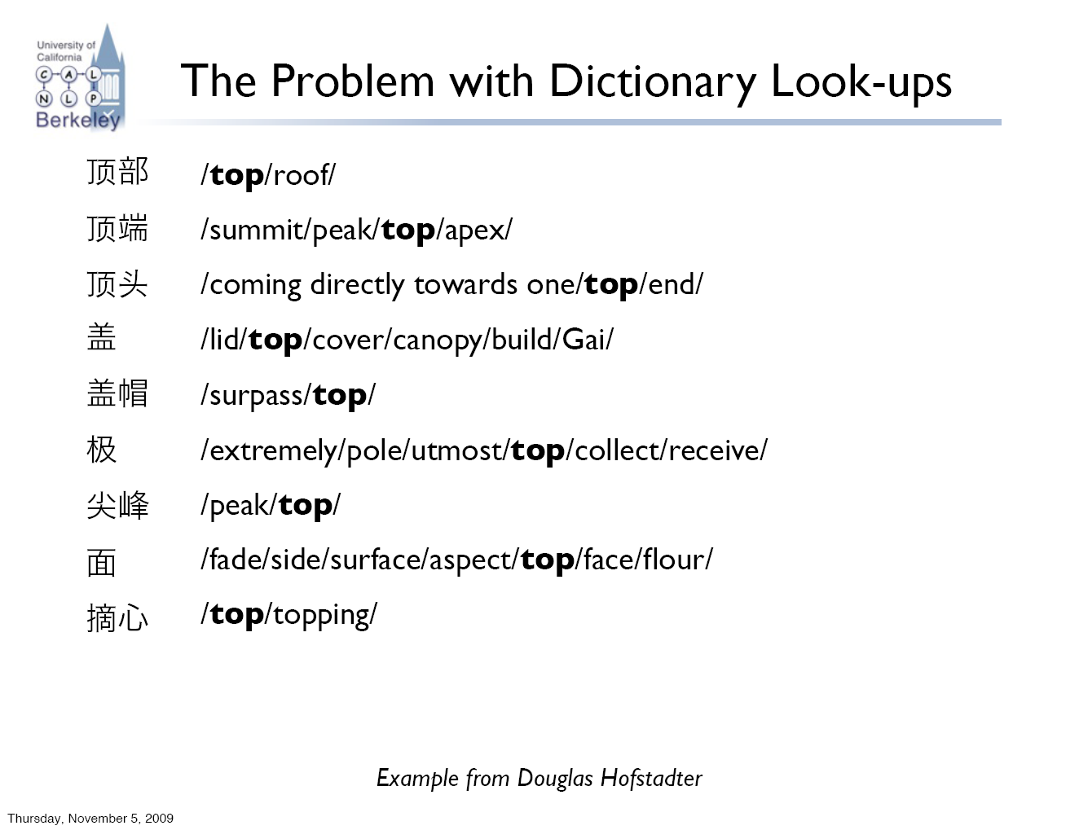
The Problem with Dictionary Lookups

Slide 17
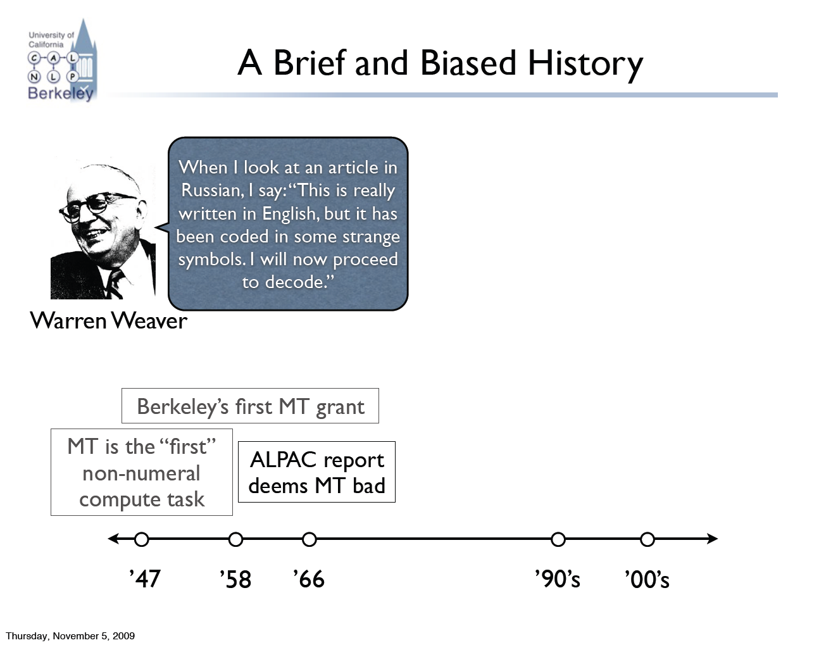
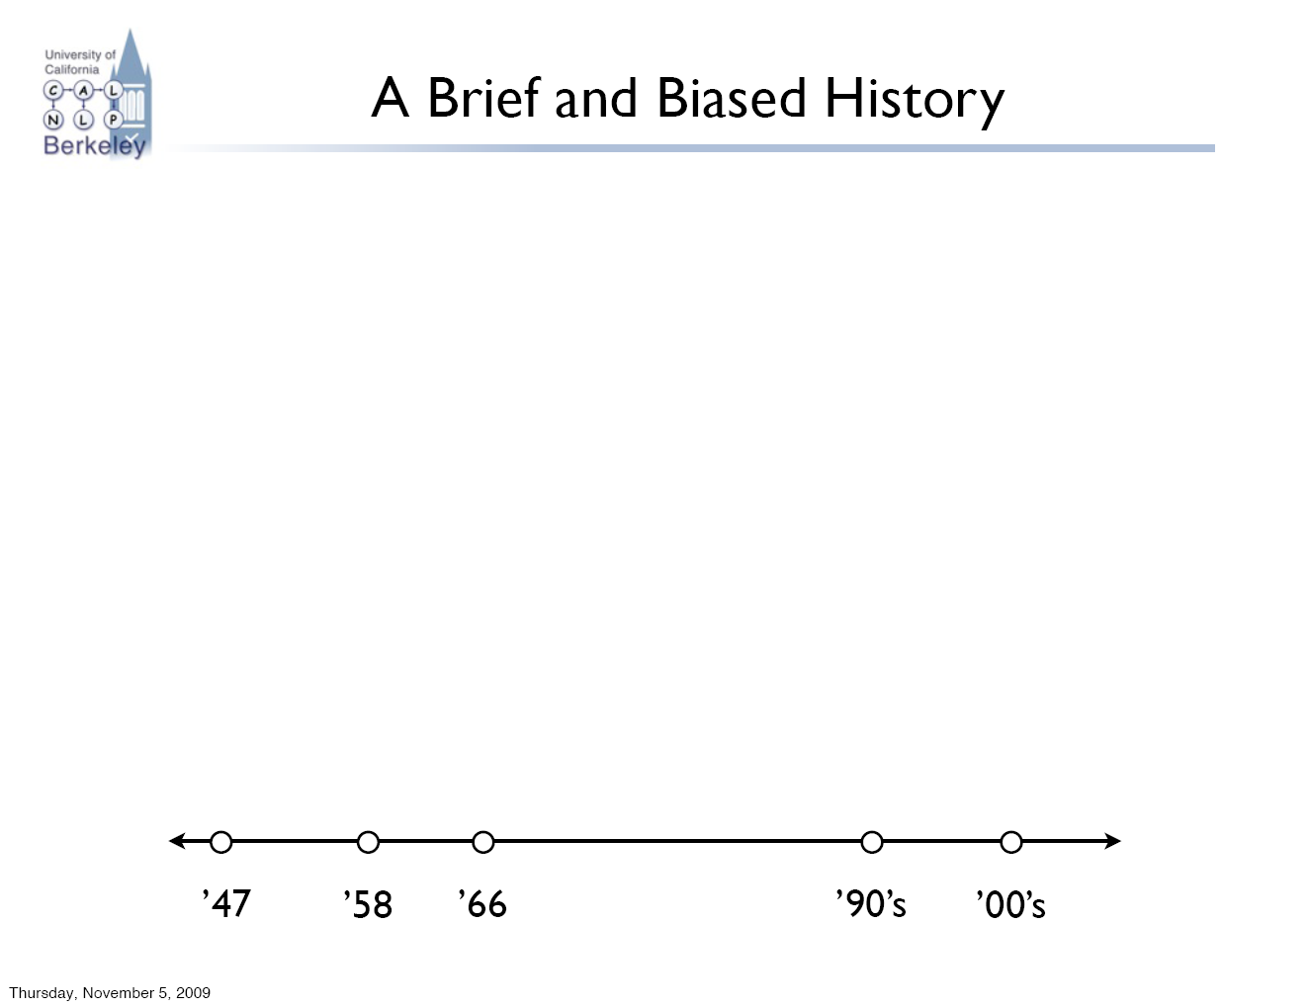
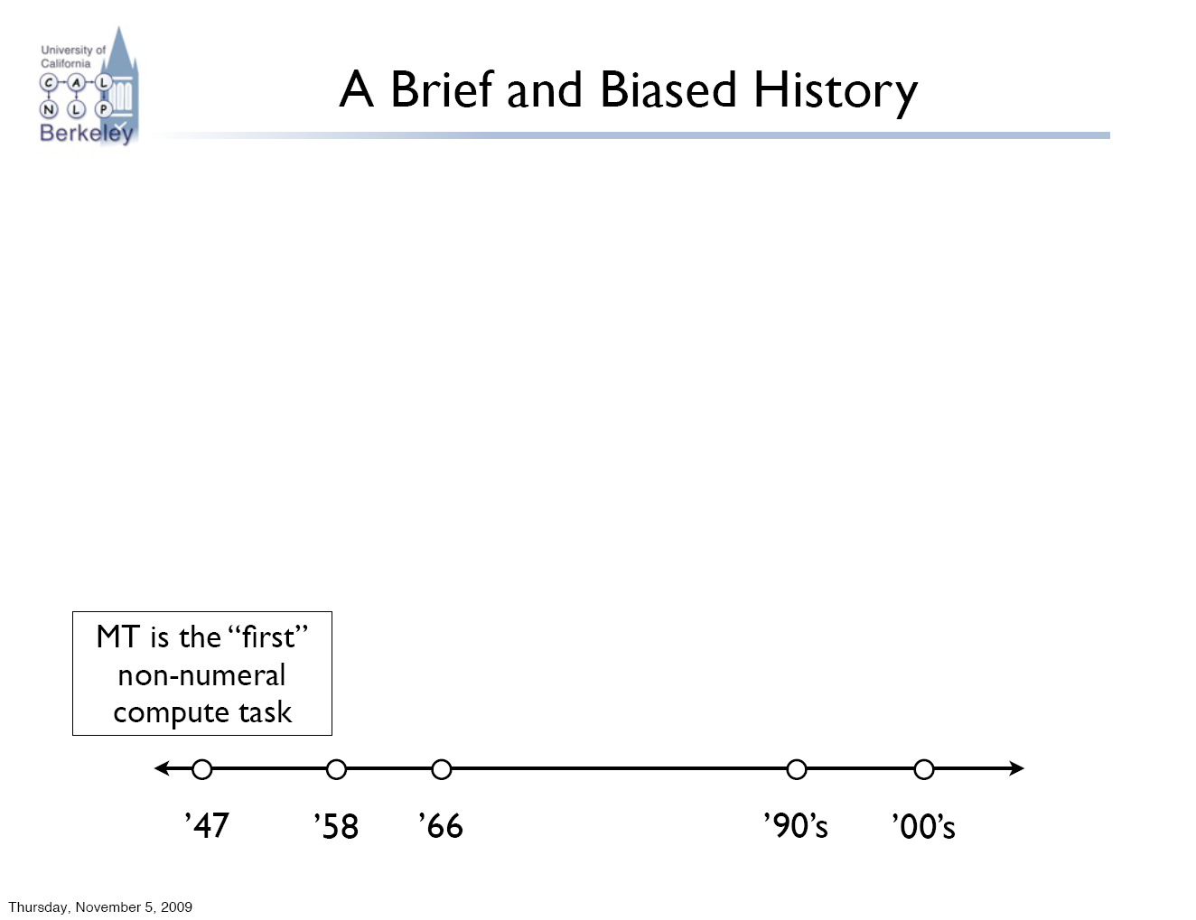
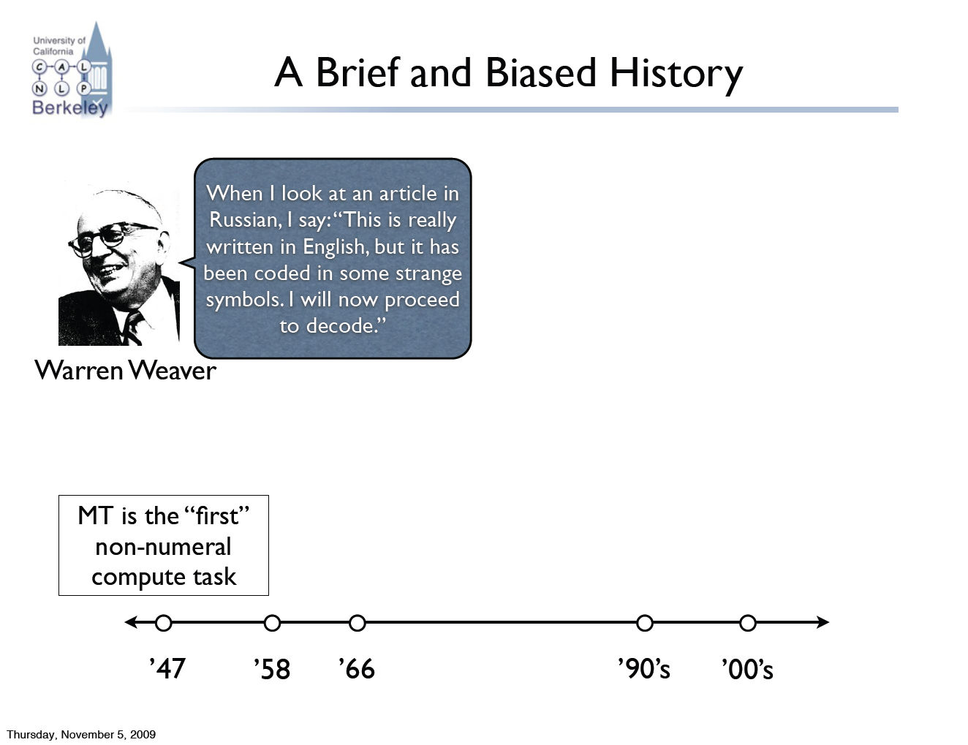
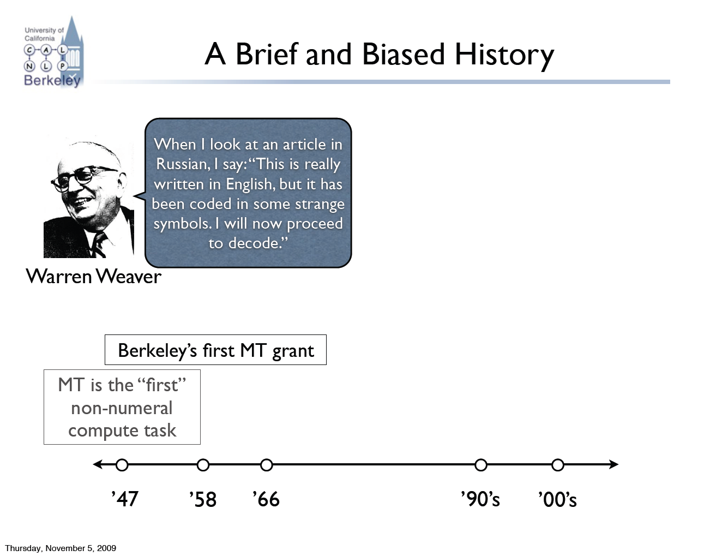
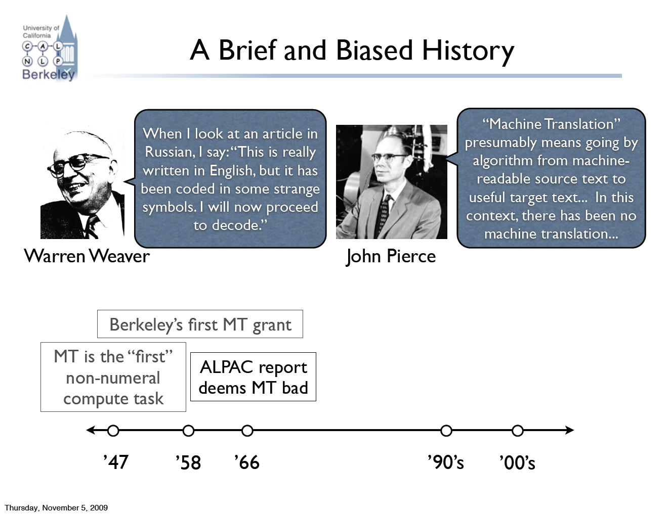
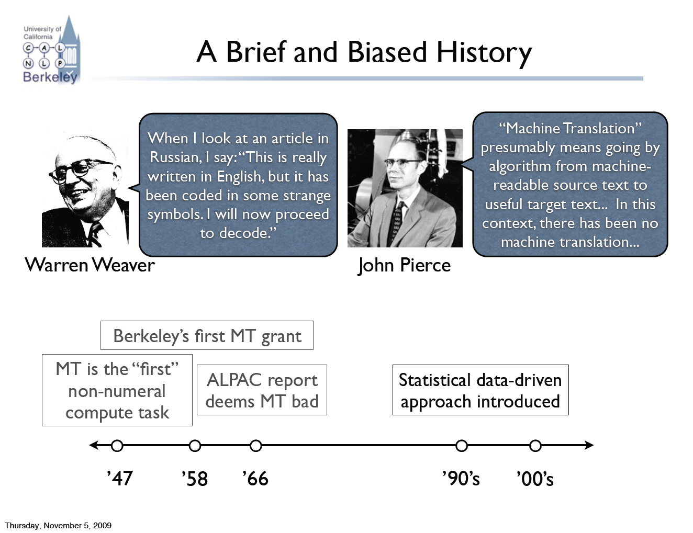
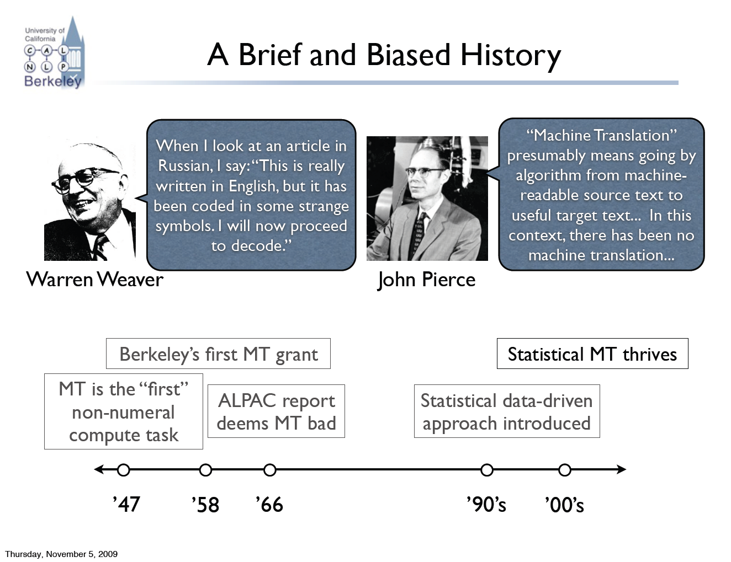
MT: 60 Years in 60 Seconds

Slide 18
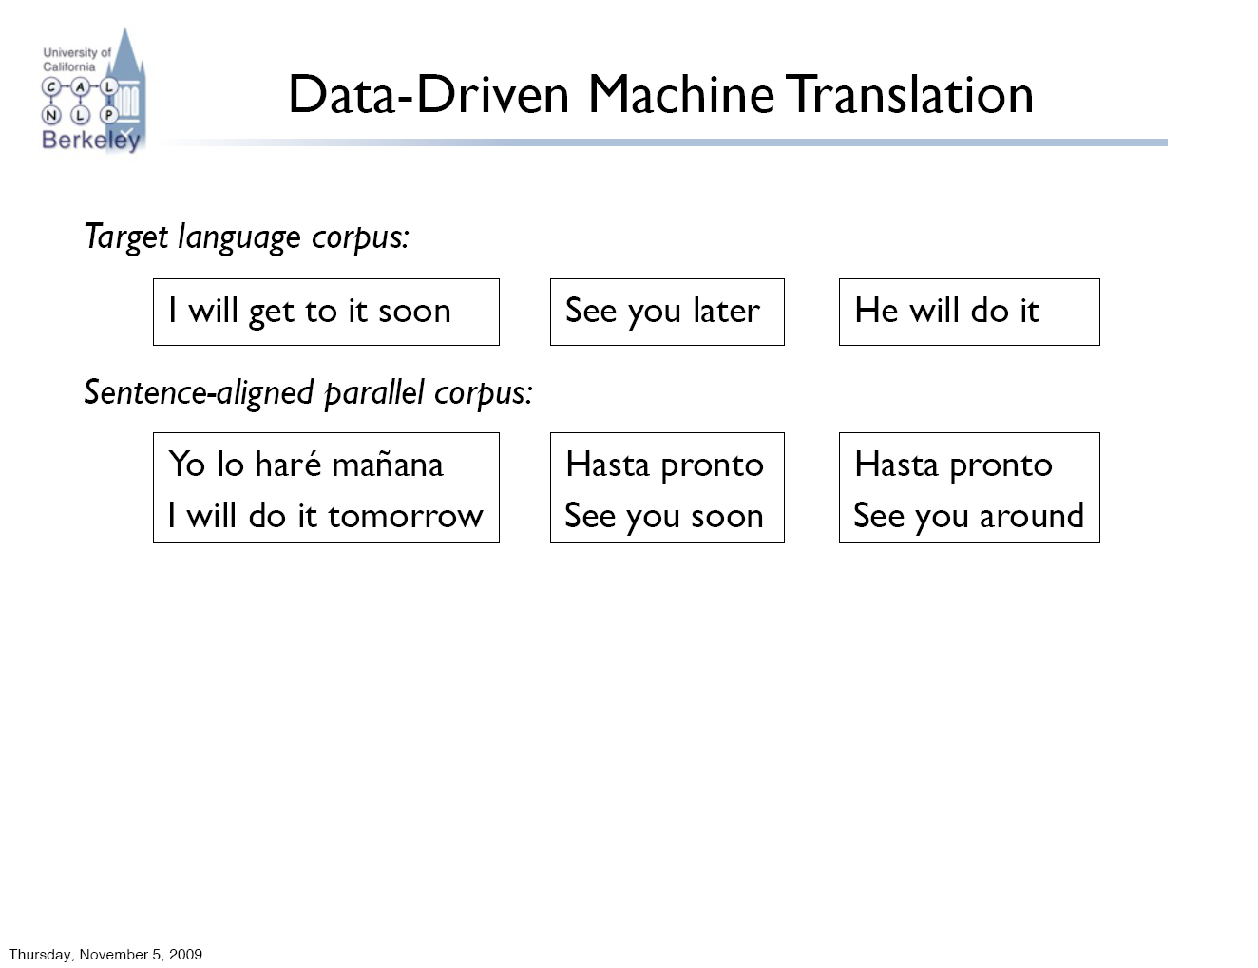
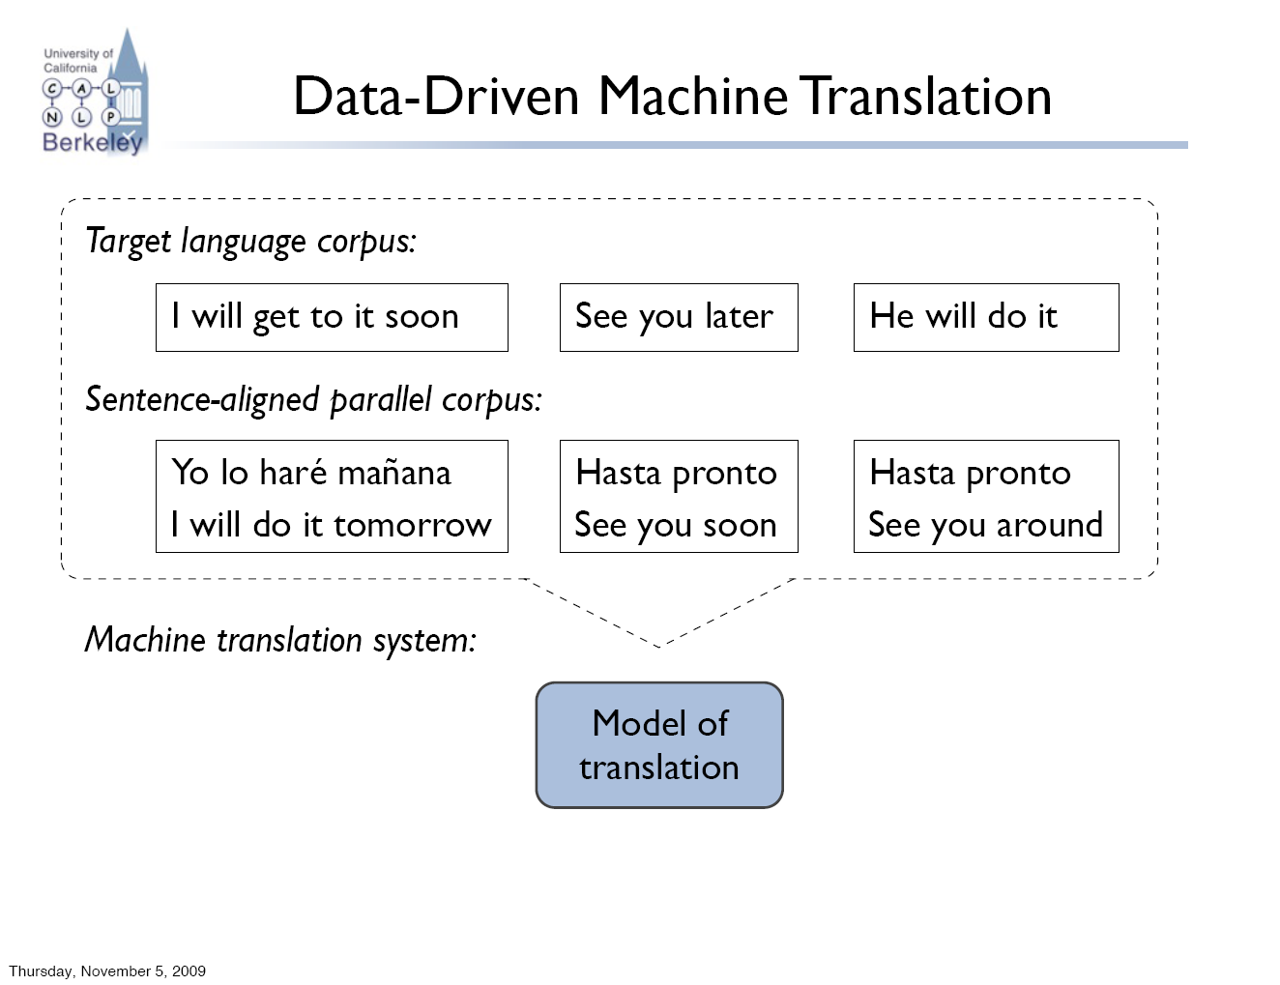
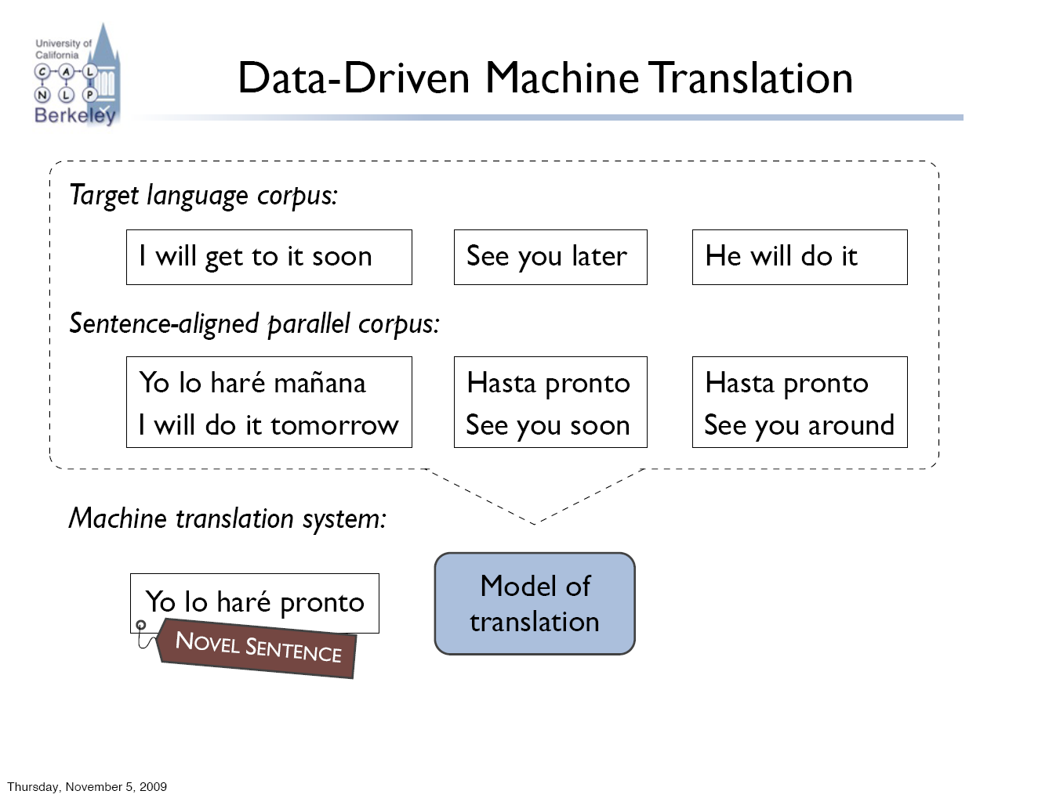
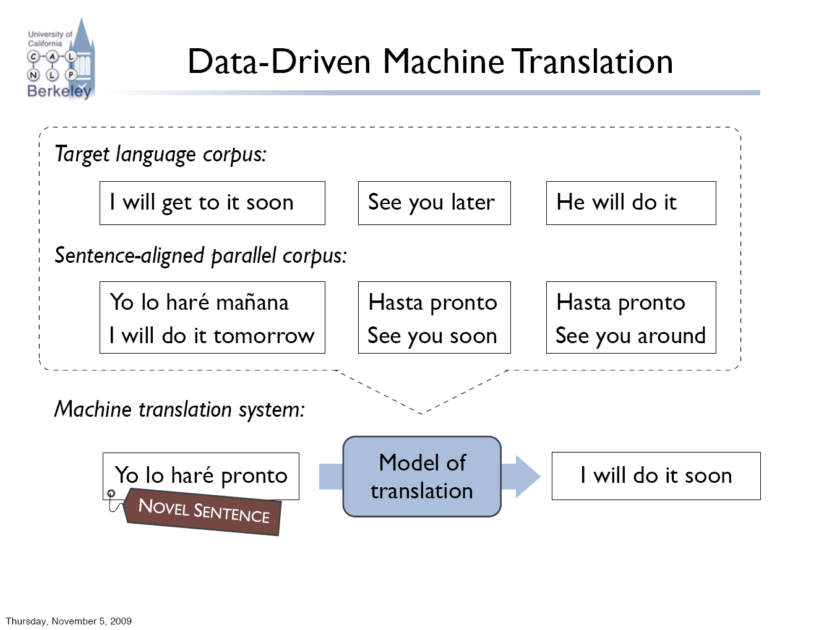
Data-Driven Machine Translation

Slide 19
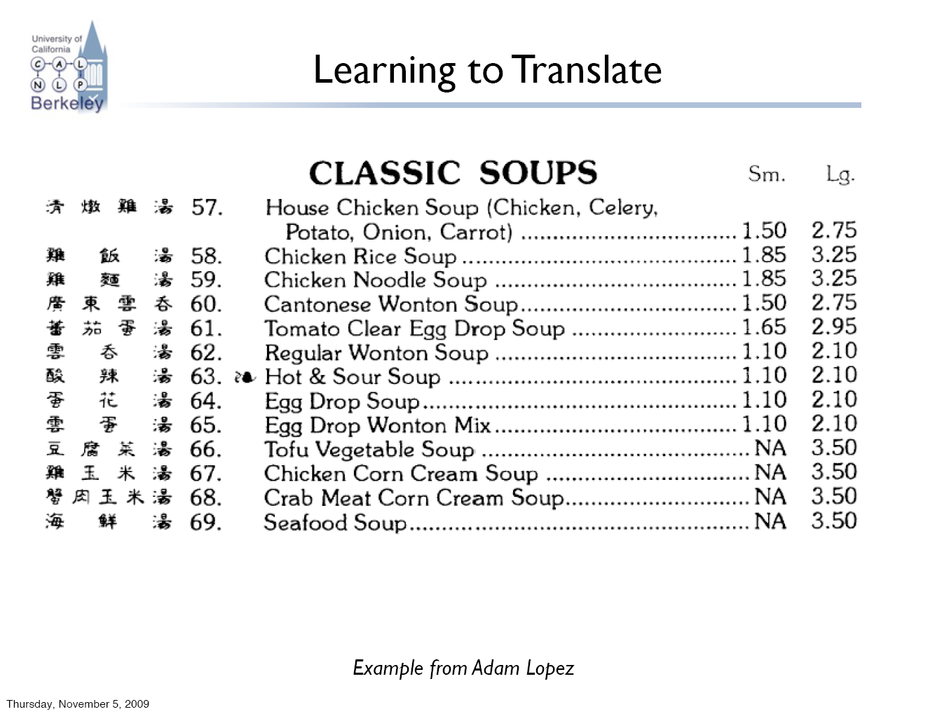
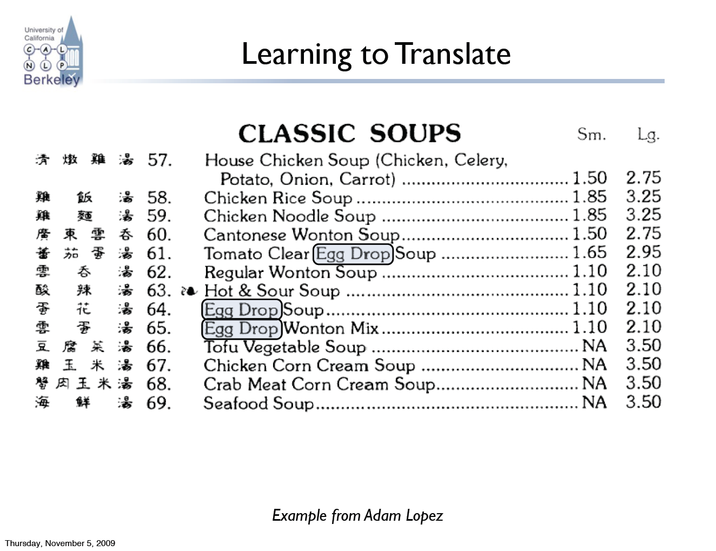
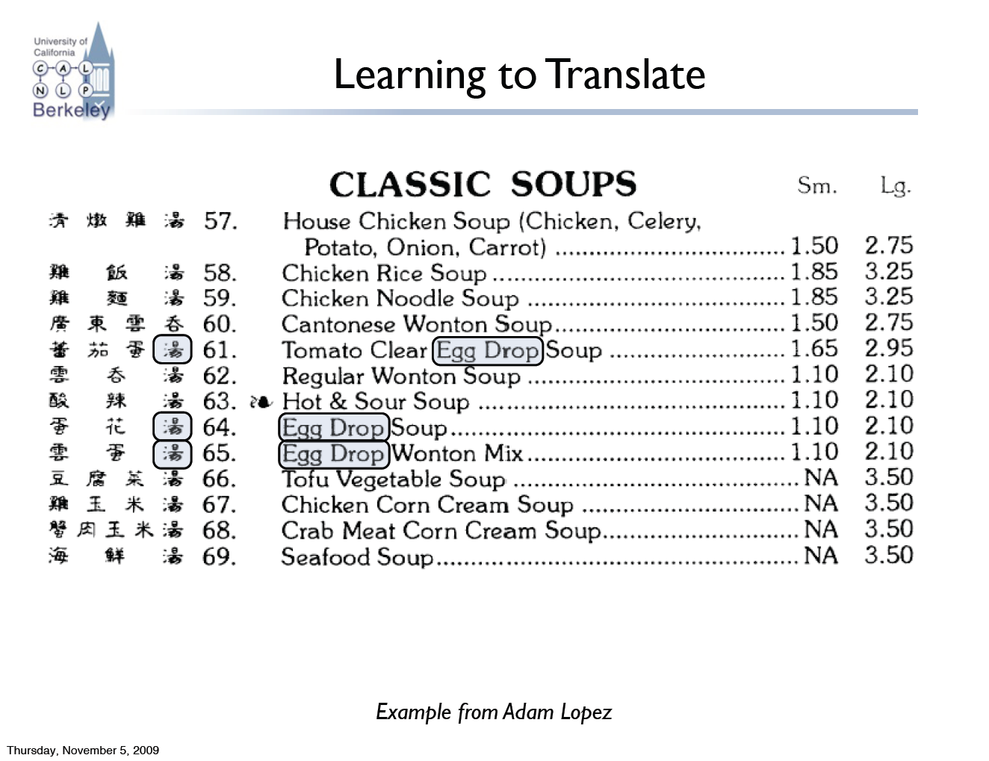
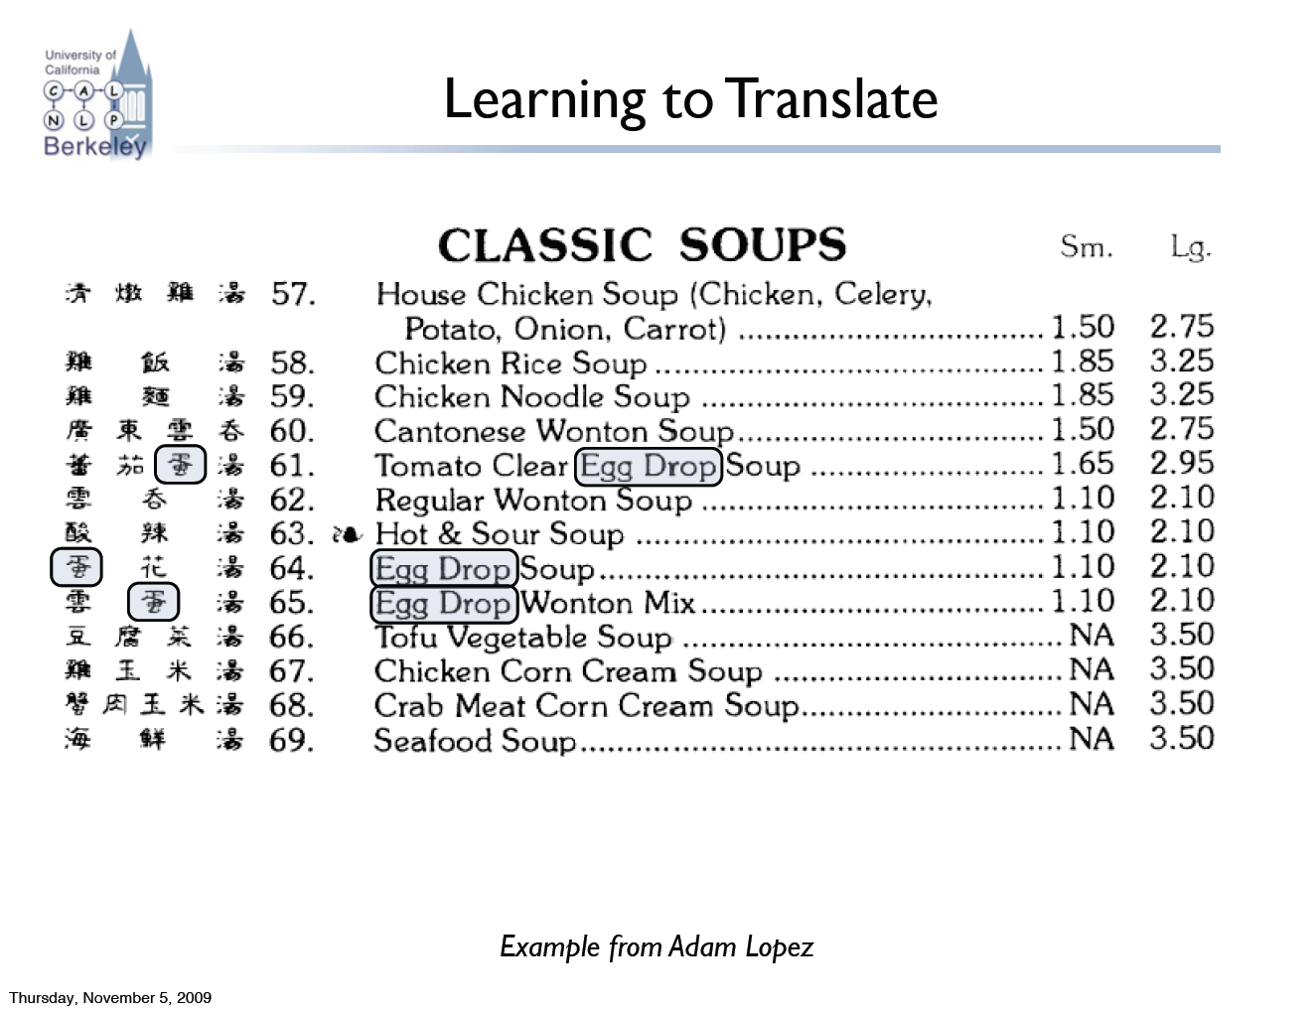
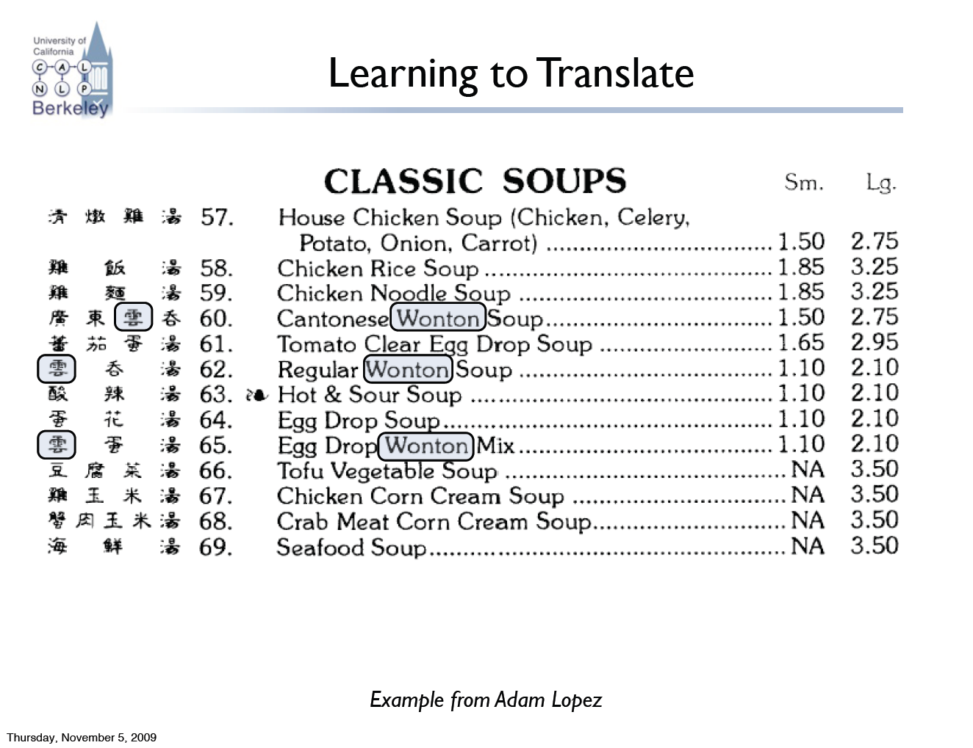
Learning to Translate

Slide 20
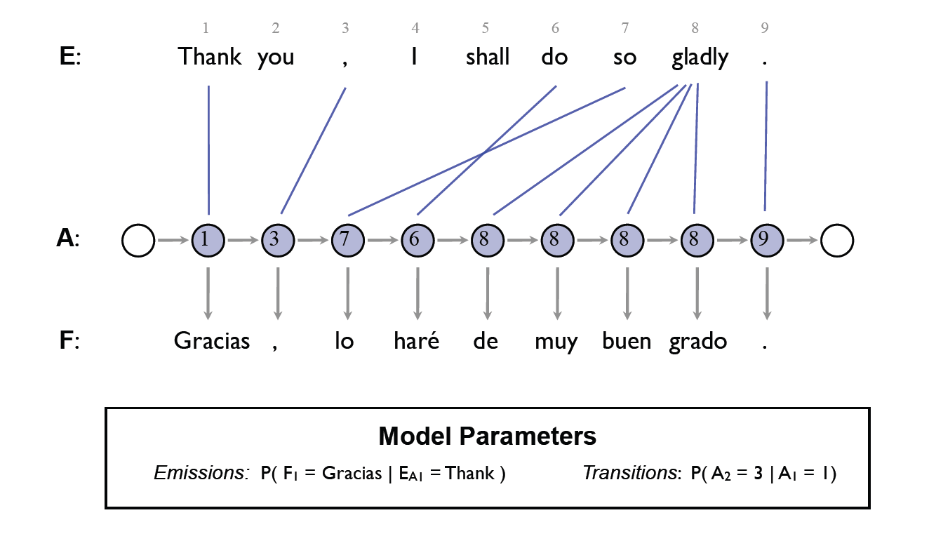
An HMM Translation Model

Slide 21
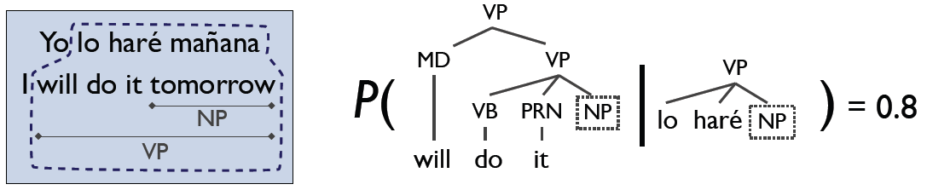
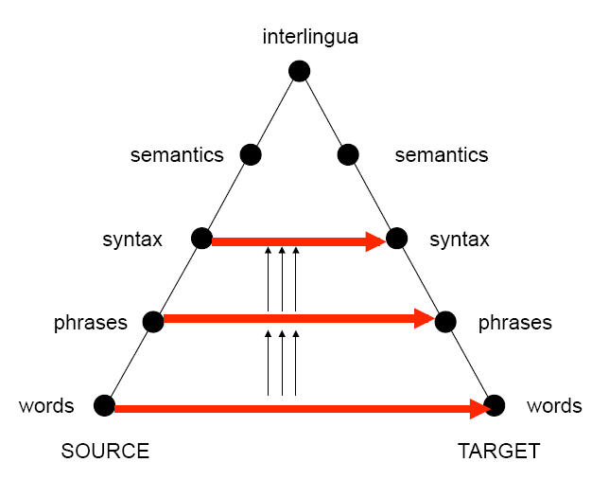
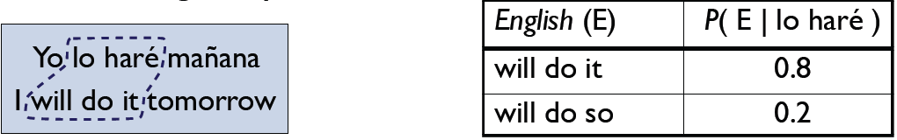
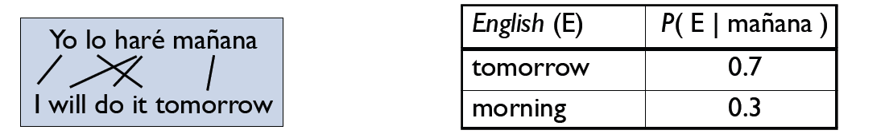
Levels of Transfer

Slide 22



Syntactic Translation

Slide 23



A Syntactic MT System

Slide 24

Example: Syntactic MT Output
[ISI MT system output]

Slide 25

Starcraft

Slide 26
Starcraft

Slide 27

What is Starcraft?
Image from Ben Weber

Slide 28


Why is Starcraft Hard?
The game of Starcraft is:
Adversarial
Long Horizon
Partially Observable
Realtime
Huge branching factor
Concurrent
Resource-rich
…
No single algorithm (e.g. minimax) will solve it off-the-shelf!

Slide 29




Starcraft AIs: AIIDE 2010
28 Teams: international entrants, universities, research labs…

Slide 30

The Berkeley Overmind
Search: path planning
CSPs: base layout
Minimax: targeting
Learning: micro control
Inference: tracking units
Scheduling: resources
Hierarchical control
http://overmind.eecs.berkeley.edu

Slide 31

Search for Pathing
[Pathing]

Slide 32

Notes:
Video: Berkeley Overmind – Sparky the Wonder Drone

Slide 33

Minimax for Targeting
[Targeting]

Slide 34

Notes:
Video: Berkeley Overmind – Mutalisk Hit and Run

Slide 35

Machine Learning for Micro Control
[RL, Potential Fields]

Slide 36

Inference / VPI / Scouting
[Scouting]

Slide 37




AIIDE 2010 Competition

Slide 38

Autonomous Driving

Slide 39



Grand Challenge 2005: Barstow, CA, to Primm, NV
150 mile off-road robot race across the Mojave desert
Natural and manmade hazards
No driver, no remote control
No dynamic passing

Slide 40
An Autonomous Car
E-stop
5 Lasers
GPS
Camera
GPS compass
Radar
6 Computers
Control Screen
IMU
Steering motor

Slide 41
Actions: Steering Control
Steering Angle (with respect to trajectory)
Velocity
Error
Reference Trajectory

Slide 42

Laser Readings for Flat / Empty Road
3
2
1

Slide 43
Laser Readings for Road with Obstacle
ΔZ

Slide 44

Obstacle Detection
Trigger if |Z^{i}−Z^{j}| > 15cm for nearby z^{i}, z^{j}
Raw Measurements: 12.6% false positives

Slide 45
Probabilistic Error Model
GPS
IMU
GPS
IMU
GPS
IMU
x_{t}
x_{t+1}
x_{t+2}
z_{t}
z_{t+1}
z_{t+2}

Slide 46

HMMs for Detection
Raw Measurements: 12.6% false positives
HMM Inference: 0.02% false positives

Slide 47


Sensors: Camera

Slide 48

Urban Environments

